Slide 1
ESR Ancillary Service SOC Shortfall Analysis Report
Balancing Operations Planning Staff
July 23, 2024

Slide 2
ESR AS MW Shortfall Introduction
NPRR1186 brought improvements to ERCOT systems to better account for state of charge (SOC). These changes now allow ERCOT’s EMS to preserve SOC in SCED dispatch to maintain needed SOC to support Ancillary Service (AS) obligation in the remainder of the hour.
The approved versions of NPRR1186 and NPRR1149 as approved do not consider SOC for accounting for shortfall. This led to TAC requesting a monthly report on tracking shortfall in AS obligation due to SOC.
ERCOT proposes this report template to provide insights into insufficient SOC to provide AS obligation and inadequate response to events and dispatch due to low or insufficient SOC.
The charts on slide 5 have been built using SOC shortfall calculations over the hour which are converted to a MW shortfall value.
  Shortfall for each AS are assigned in this order (Non-Spin, ECRS, RRS, Regulation and FFR).
  AS Shortfall Cost ($) is calculated using the Market Clearing Price for Capacity (MCPC) of the Ancillary Services and the MW Short amount for each Ancillary Service for QSEs.
ERCOT intends to share a report with production data in Aug 2024 with the implementation of NPRR1186 in ERCOT systems.
  The data in this report uses preliminary data prior to official go-live of NPRR1186 to demonstrate the templates we are proposing for this report.

Slide 3
Insufficient SOC in Real Time to Provide Ancillary Service Obligation

Slide 4
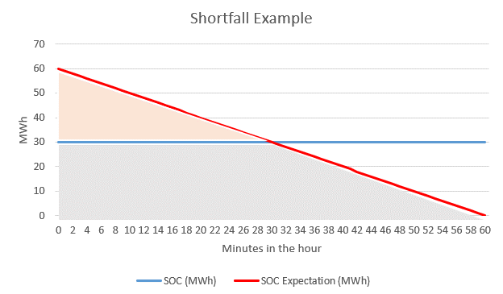
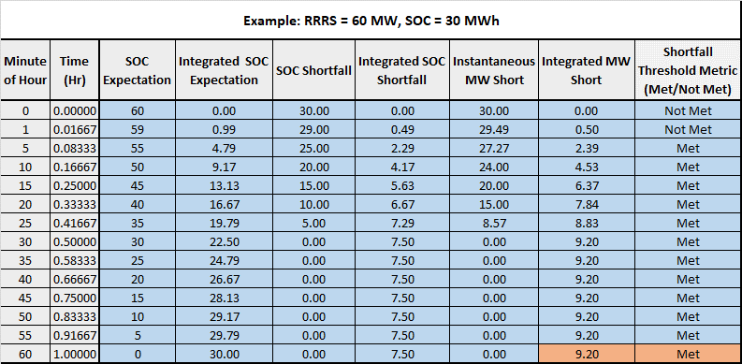
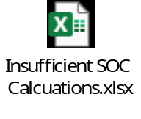
Insufficient SOC to provide Ancillary Service Obligation Example
Example: AS Responsibility of 60 MW while only telemetering 30 MWh of SOC throughout the hour.
This ESR would contribute 9.2 MW RRS Short for this hour.
This hour would be considered a Shortfall Hour due to meeting the proposed NPRR1186 shortfall threshold metric at the end of the hour. (Integrated SOC shortfall exceeds the greater of 2MWhh or the lower of 8MWhh or 20% of the integrated SOC expectation)
Attached is an excel workbook that can be used to explore shortfall scenarios in more detail.
This slide is sourced from mock data to demonstrate report capabilities.
Notes:
For a given ESR in an hour:
SOC Shortfall = SOC Expectation – SOC
Instantaneous MW Short = SOC Shortfall / (1-Time)
Integrated MW Short = Integration of Instantaneous MW Short over the hour
MW Short for the hour = Integrated MW Short at the final interval of the hour
The MW Short for the hour is aggregated for all ESRs across all hours in the month. It is referred to as MW Short in this slide deck.

Slide 5
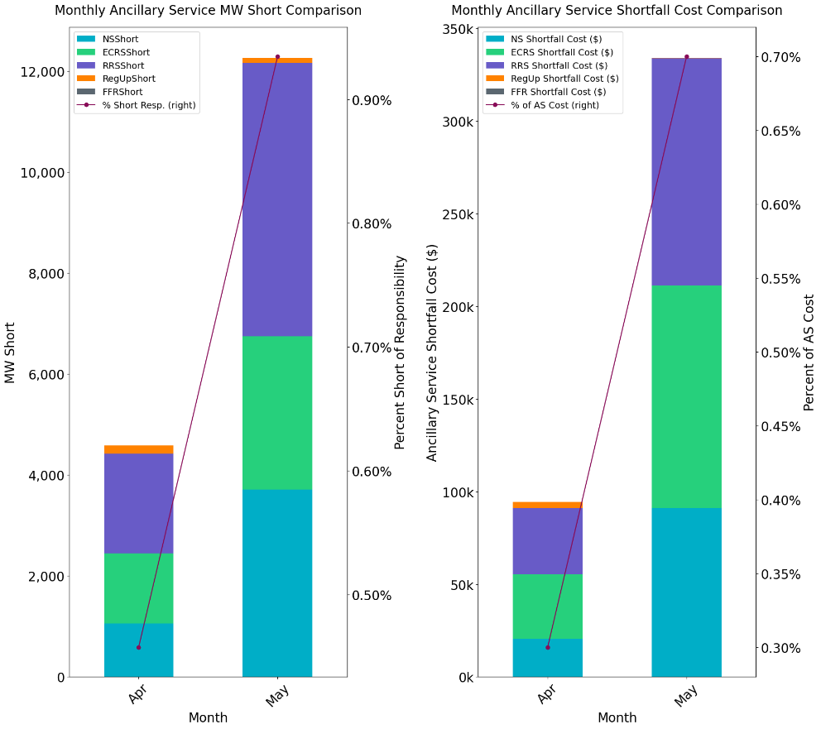
Insufficient SOC to provide Ancillary Service Obligations if system conditions require (Month over Month)
An ESRs Shortfall is converted a to MW value and system-wide AS MW Short is computed for every hour (referred to as MW Short). Ancillary Service Shortfall costs are determined using MW Short and historical MCPC.
* % Short of AS Responsibility = (Monthly ESR MW Short / Monthly ESR AS Responsibility)*100
** % of AS Cost = (Monthly AS Shortfall Cost from ESRs / Monthly Total MCPC of the AS Carried by ESRs) * 100
Observation:
[Insert Trend Observations]
This slide is sourced from mock data to demonstrate report capabilities.

Slide 6
Inadequate Response During Real Time Events and Dispatch

Slide 7
Inadequate response from ESRs during unit trips when carrying RRS with low SOC^
  This data is sourced from the ERCOT BAL-TRE-001 FME tool. Low SOC is determined using telemetered SOC, MXOS, MNOS. SOC % = ((SOC-MNOS)/MXOS)*100.
  * RRS-FFR performance is determined solely on sufficient MW response being provided.
  ** FMEs and Non-FMEs which were reported to PDCWG.
  ^ Low SOC is set to 20% for this analysis, this is a configurable parameter.
 | RRS-PFR | RRS-FFR |  | RRS-FFR
Event Date | Evaluated ESRs | Low SOC ESRs |  | Evaluated ESRs | Low SOC ESRs |  | Frequency Events**
 |  | Evaluated | Failed |  | Evaluated | Failed*
1/1/2024 20:13 | 35 | 0 | 0 | 0 | 0 | 0 | FME
2/27/2024 9:21 | 50 | 1 | 1 | 8 | 0 | 0 | Non-FME
2/28/2024 2:29 | 65 | 0 | 0 | 0 | 0 | 0 | FME
2/28/2024 10:15 | 61 | 0 | 0 | 0 | 0 | 0 | Non-FME
3/12/2024 8:16 | 45 | 0 | 0 | 0 | 0 | 0 | Non-FME
3/17/2024 15:16 | 67 | 1 | 0 | 0 | 0 | 0 | Non-FME
3/24/2024 20:25 | 50 | 0 | 0 | 0 | 0 | 0 | Non-FME
4/8/2024 22:29 | 70 | 0 | 0 | 0 | 0 | 0 | Non-FME
4/10/2024 20:55 | 57 | 0 | 0 | 0 | 0 | 0 | FME
4/13/2024 18:05 | 44 | 0 | 0 | 0 | 0 | 0 | Non-FME
Observation: In April none of the ESRs carrying RRS that were evaluated during unit trips had a low SOC.
This slide is sourced from mock data to demonstrate report capabilities.
Notes:
RRS-PFR is evaluated on ERCOT-RRS metric (1% droop).

Slide 8
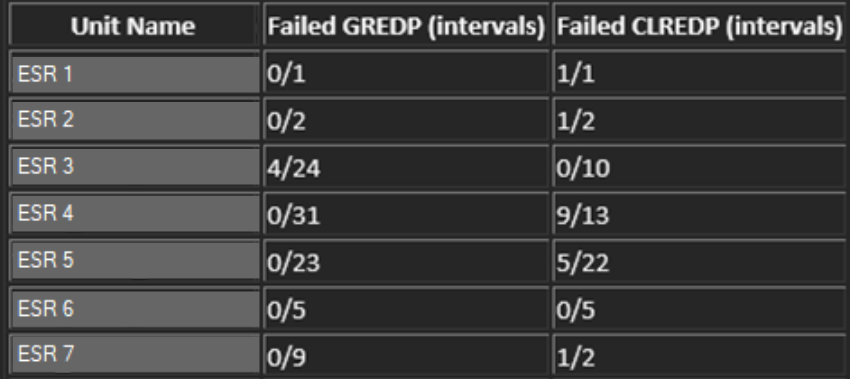
Inadequate output following dispatch setpoints when carrying AS with low SOC^
GREDP and CLREDP formulas from Protocols are used to compute how closely an ESR providing Ancillary Services followed its setpoints* in low SOC intervals. Low SOC is determined using telemetered SOC, MXOS, MNOS. SOC % = ((SOC-MNOS)/MXOS)*100.
* Setpoint is calculated as Base Point + regulation instruction + expected PFR
^ Low SOC is set to 20% for this analysis, this is a configurable parameter.
Month | ESR GREDP Interval Failures | ESR CLREDP Interval Failures | Total Intervals on Low SOC with AS
April 2024 | 4 | 17 | 95
Observation:
In April, there are few instances of ESRs failing GREDP with low SOC and AS Responsibility.
This slide is sourced from mock data to demonstrate report capabilities.
Notes:
^ Low SOC is configurable.

Slide 9
Summary
ERCOT plans to share this report with production data:
  With WMWG monthly.
  The first available report will be produced using production data from July 2024.
ERCOT is seeking feedback on this report template and any additional analysis that may need to be included that could help share findings.
Please provide any feedback to Luis Hinojosa at jhinojosa@ercot.com by end of July.

Slide 10
Appendix

Slide 11
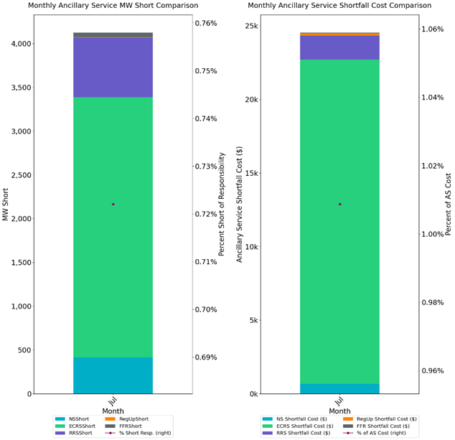
Insufficient SOC to provide Ancillary Service Obligations if system conditions require (Month over Month)
An ESRs Shortfall is converted a to MW value and system-wide AS MW Short is computed for every hour (referred to as MW Short). Ancillary Service Shortfall costs are determined using MW Short and historical MCPC.
* % Short of AS Responsibility = (Monthly ESR MW Short / Monthly ESR AS Responsibility)*100
** % of AS Cost = (Monthly AS Shortfall Cost from ESRs / Monthly Total MCPC of the AS Carried by ESRs) * 100
Observation:
[Insert Trend Observations]
This slide is sourced from 7/1/2024-7/16/2024 production data.

Slide 12
Inadequate response during unit trips when carrying RRS with low SOC^
  This data is sourced from the ERCOT BAL-TRE-001 FME tool. Low SOC is determined using telemetered SOC, MXOS, MNOS. SOC % = ((SOC-MNOS)/MXOS)*100.
  * RRS-FFR performance is determined solely on sufficient MW response being provided.
  ** FMEs and Non-FMEs which were reported to PDCWG.
  ^ Low SOC is set to 20% for this analysis, this is a configurable parameter.
 | RRS-PFR | RRS-FFR |  | RRS-FFR
Event Date | Evaluated ESRs | Low SOC ESRs |  | Evaluated ESRs | Low SOC ESRs |  | Frequency Events**
 |  | Evaluated | Failed |  | Evaluated | Failed*
6/29/2024 19:57 | 45 | 0 | 0 | 0 | 0 | 0 | FME
Observation: In the June FME, none of the ESRs carrying RRS that were evaluated had a low SOC.
Notes:
RRS-PFR is evaluated on ERCOT-RRS metric (1% droop).

Slide 13
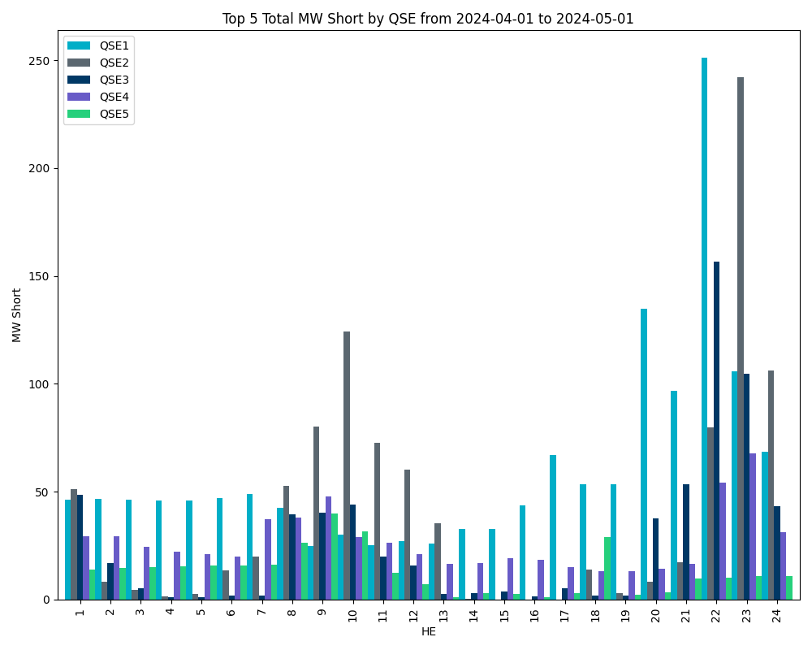
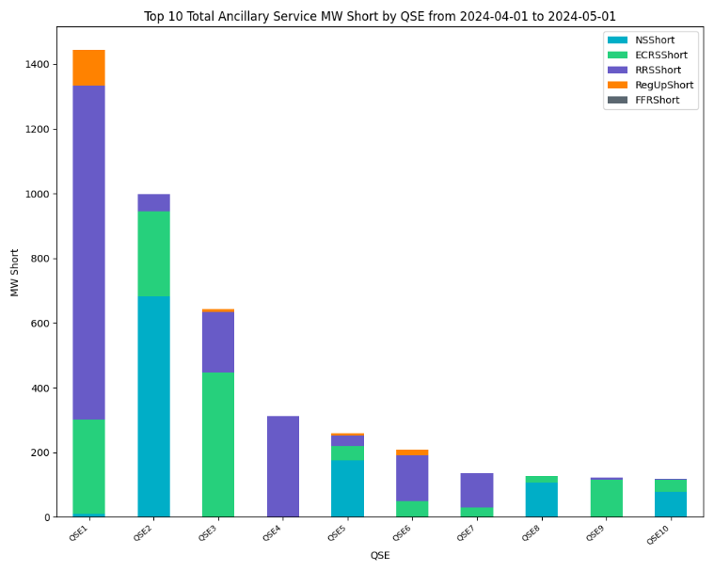
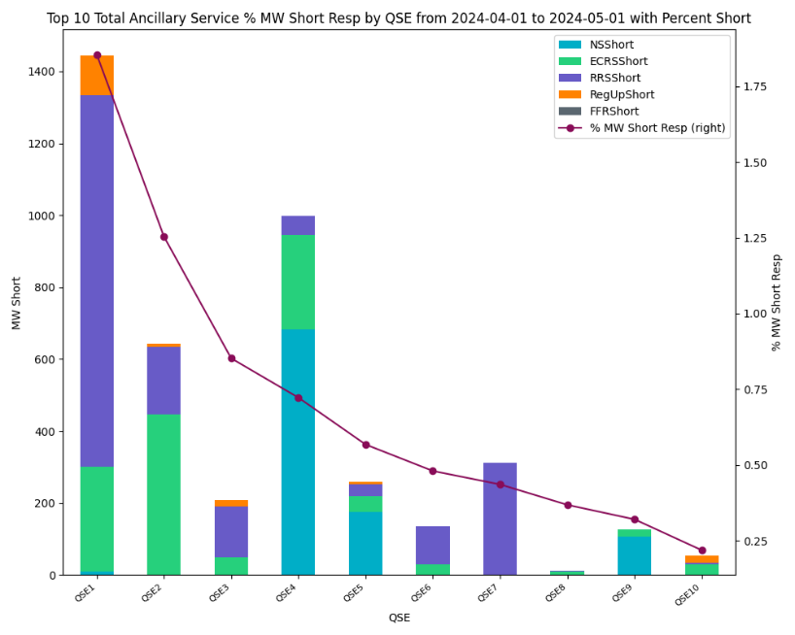
Insufficient SOC to provide Ancillary Service Obligations if system conditions require (April 2024 by QSE)
Observation: [Insert QSE Trend Observations]
This slide is sourced from mock data to demonstrate report capabilities.

Slide 14
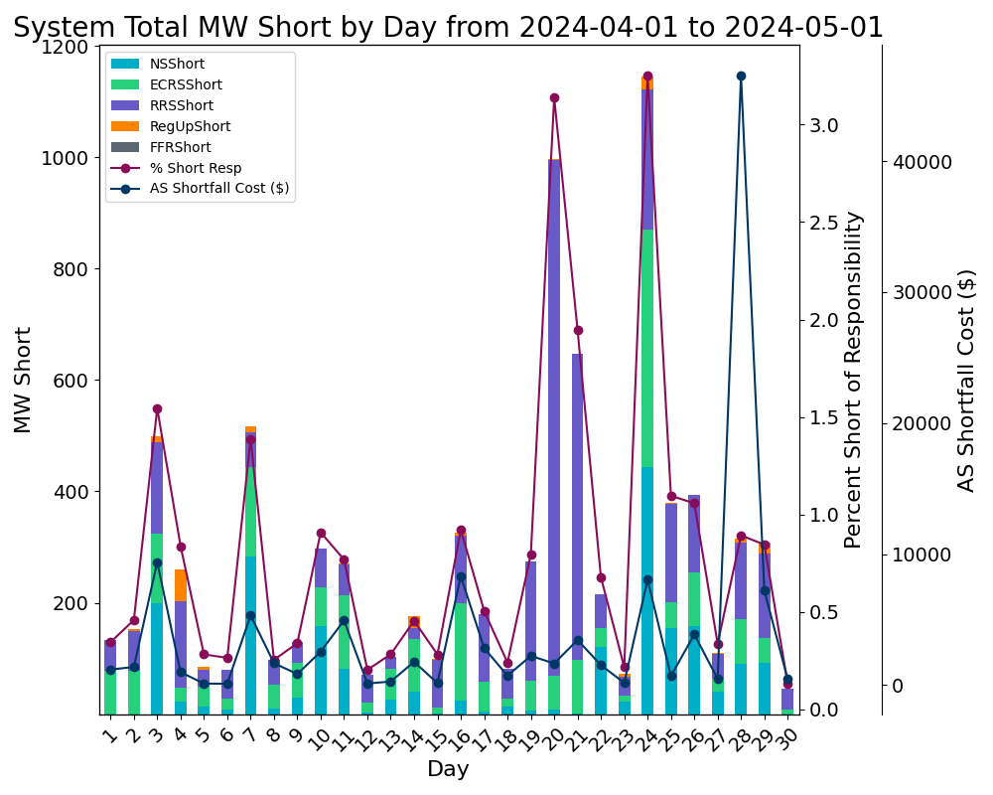
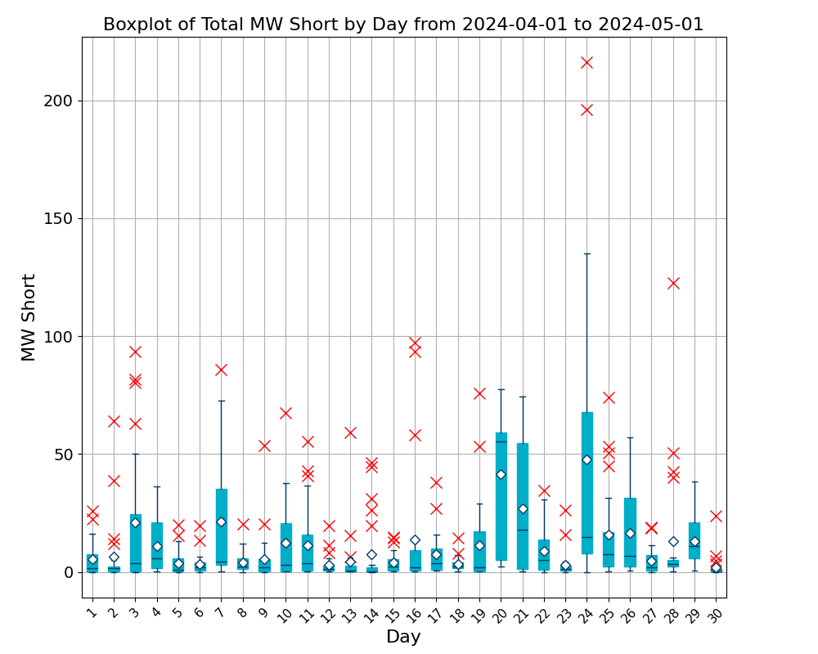
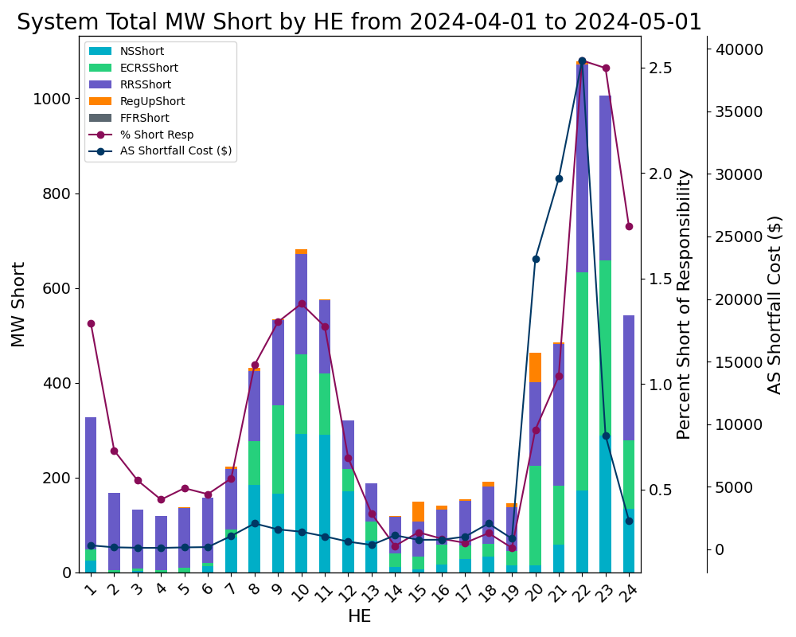
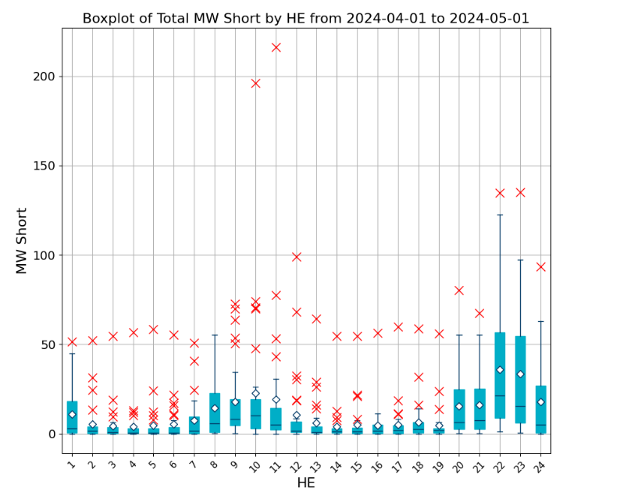
Insufficient SOC to provide Ancillary Service Obligations if system conditions require (April 2024)
Shortfalls are converted to MW values (referred to as MW Short) and grouped by HE and Day of the month. Ancillary Service Shortfall costs are determined using MW Short and historical MCPC.
Observation:
Top 3 day with largest AS MW short due to SOC: April 24, 20 and 21 largest AS MW short due to SOC
Top 3 day with largest AS $ short due to SOC: April 28, April 29, April 16
Top 5 Hours with AS MW short due to SOC: HE22, HE23, HE24, HE20, HE21
This slide is sourced from mock data to demonstrate report capabilities.

